Slide 1


Name : Abdul Jaweed
Date : 20 Dec 2022

Slide 2

Outline
Executive Summary
Introduction
Methodology
Results
Conclusion
Appendix

Slide 3
Executive Summary
In this capstone project, we will predict the SpaceX Falcon 9 first stage will land successfully. If we can determine if the first stage will land, we can determine the cost of a launch. This will be achieved with the use of different machine learning classification algorithms.
The methodology followed will include data collection, data wrangling and pre-processing, (EDA) exploratory data analysis, data visualization and finally, machine learning prediction.
During our investigation, the results of our analysis indicate that there are some features of rocket launches that have a correlation with the success or failure launches.
In the end we conclude that except decision tree all three model perform same accuracy and may be the best machine learning algorithm to for this problem.

Slide 4
Introduction
The main goal of this capstone project is to predict whether the Falcon 9 first stage will land successfully.
Because Space X advertises Falcon 9 rocket launches on its website with a cost of 62 million dollars; other providers cost upward of 165 million dollars each, much of the savings is because Space X can reuse the first stage.
Therefore if we can determine if the first stage will land, we can determine the cost of a launch. This information can be used if an alternate company wants to bid against SpaceX for a rocket launch.
This brings us to our main question that we are trying to answer : For a given set of features
about a Falcon 9 rocket launch, will the first stage of the rocket land successfully?

Slide 5

Section 1

Slide 6
Methodology
The data was collected by two methods : 1. SpaceX API and 2. Web scraping.
Data wrangling or data cleaning was performed to transform and clean data using pandas Python library.
Using clean data to perform (EDA) exploratory data analysis using SQL queries and python visualization libraries like matplotlib and seaborn.
Using Folium library to create a map and using Plotly Dash library to create a Dashboard.
Using Render hosting service to deploy our dashboard.
Using multiple machine learning classification models to perform a best predictive score.

Slide 7
Data Collection – SpaceX API
Requesting API and Web Scrapping
Json data normalize to dataframe
Only relevant columns will be extracted
Converting dictionary to dataframe using pandas
Falcon 9 launches dataframe filtering
Handling missing values
Export to CSV format
GitHub link : Data Collection API

Slide 8
Data Collection – Web Scraping
Requesting Falcon9 wiki page for Web Scrapping
Extracting all columns and names from html table header
Converting to dataframe
Export to CSV format
GitHub link : Data Collection Web Scraping

Slide 9
Data Wrangling
Calculate the number of launches on each site
Calculate the number and occurrence of each orbit
Calculate the number and occurrence of each mission outcome per orbit type
Export to CSV format
Create a landing outcome label from outcome column using one-hot encoding
GitHub link : Data Wrangling

Slide 10
EDA with Data Visualization
GitHub link : EDA with Data Visualization
Scatter plots : Scatter plots were used to represent the relationship between the two variables. Different sets of features were compared such as Flight Number vs. Launch Site, Payload vs. Launch Site, Flight Number vs. Orbit Type and Payload vs. Orbit Type.
Bar chart : Bar charts were used to makes it easily to compare values between multiple groups at a glance. The x-axis represents a category and the y-axis represents a discrete value. Bar charts were used to compare the Success Rate for different Orbit Types.
Line chart : Line charts are used to showing the data trends over time. A line chart was used to show Success Rate over a certain number of years.

Slide 11
EDA with SQL
GitHub link : EDA with SQL
Displaying the unique launch sites in the space mission
Displaying first 5 records where launch sites begin with the string ‘CCA’
Displaying the total payload mass carried by boosters launched by NASA (CRS)
Displaying average payload mass carried by boasted version F9 v1.1
Listing the date when the first successful landing outcome in ground pad was achieved

Slide 12
EDA with SQL
Listing the names of the boosters which have success in drone ship and have payload mass greater than 4000 but less than 6000.
Listing the total number of successful and failure mission outcomes
Listing the names of the booster versions which have carried maximum payload mass.
Listing the failed landing outcomes in drone ship, their booster versions and launch site names for in year 2015
Ranking the count of landing outcomes (such as Failure (drone ship) or Success (ground pad)) between the date 2010-06-04 and 2017-03-20, in descending order

Slide 13
Build an Interactive Map with Folium
GitHub link : Building an Interactive Map with Folium
Objects was created and added to a Folium map. Marker objects were used to show all launch sites on a map as well as the successful/failed launches for each site on the map. Line objects were used to calculate the distances between a launch site to its proximities
Adding these objects by following geographical patterns about the launch sites are found:
Do launch sites keep certain distance away from cities? Yes
Are launch sites in close proximity to highways? Yes
Are launch sites in close proximity to coastline? Yes
Are launch sites in close proximity to railways? Yes

Slide 14
Build a Dashboard with Plotly Dash
GitHub link : SpaceX Launch Records Dashboard
Dashboard link : SpaceX Launch Records Dashboard
The Dashboard Application contain two charts:
1. Pie-Chart : shows the successful launch by each site.
2. Scatter Plot : shows the relationship between landing outcomes on the payload mass of different boosters.
Bonus-one : I deploy this dashboard on render web hosting service

Slide 15
Predictive Analysis (Classification)
Standardizing the data
Splitting data for training and testing
Find the best hyperparameter
Matrix Model Evaluation
Creating Column for “Class”
GitHub link : Space-X Machine Learning Prediction

Slide 16
Results
The results of the (EDA) exploratory data analysis revealed the success rate of the SpaceX Falcon 9 rocket landings is 66%.
The predictive analysis results showed that the Decision Tree Algorithm is less accuracy and Logistic Regression, Support Vector Machine and K Nearest Neighbors was same accuracy and the classification method accuracy is 83%.

Slide 17

Section 2

Slide 18
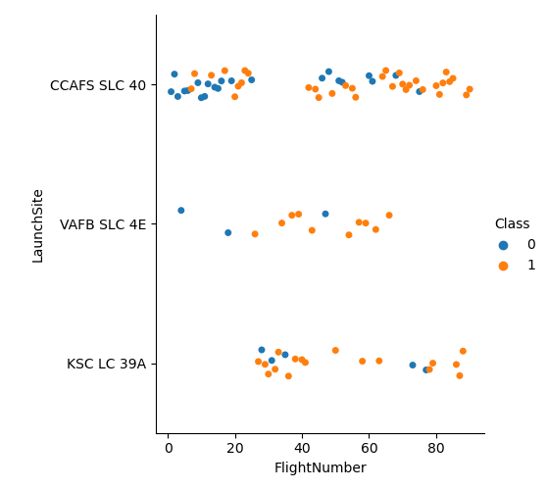
Flight Number vs. Launch Site
This figure shows that the success rate has increased as the number of flight increased.
The blue dots represent the unsuccessful launches while the orange dots represent successful launches.
This figure showing that was more successful after the 40th Launch.

Slide 19
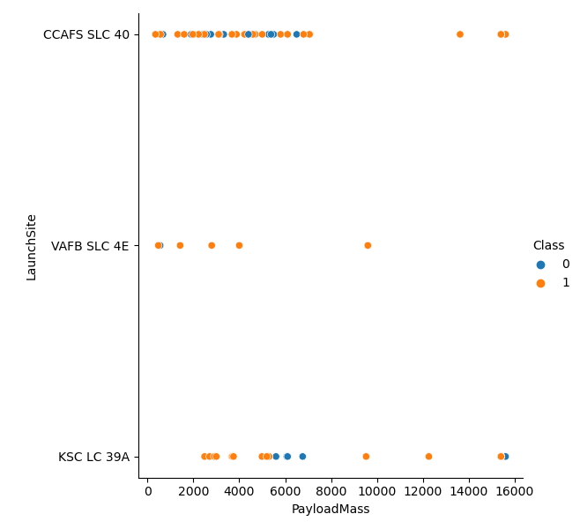
Payload vs. Launch Site
The blue dots represent the unsuccessful launches while the orange dots represent successful launches.
CCAFS SLC 40 was a launch site was more rocket launches compare to other.
VAFB SLC 4E launch site was the less rocket launches and no rocked launched for heavy payload mass
KSC LC 39A launch site was the more success rate.

Slide 20
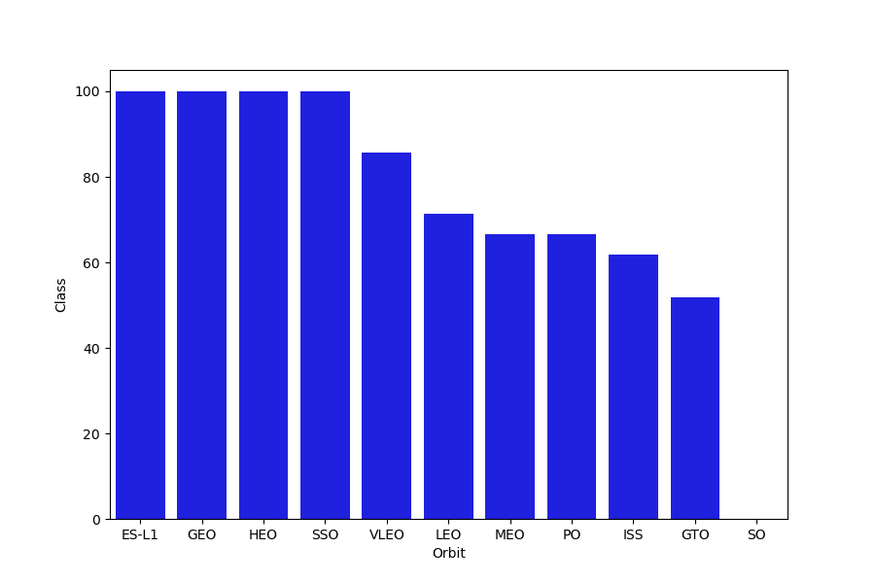
Success Rate vs. Orbit Type
Orbit ES-L1, GEO, HEO, and SSO has a 100% success rates.
Orbit did not have any successful launches with a 0% success rate.

Slide 21
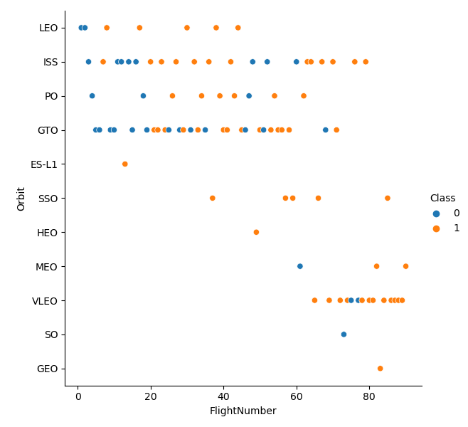
Flight Number vs. Orbit Type
GEO orbit have only one success rate.
SO orbit have only one fail.
ISS orbit have more success rate.
GTO orbit have combination of both success or fail.

Slide 22
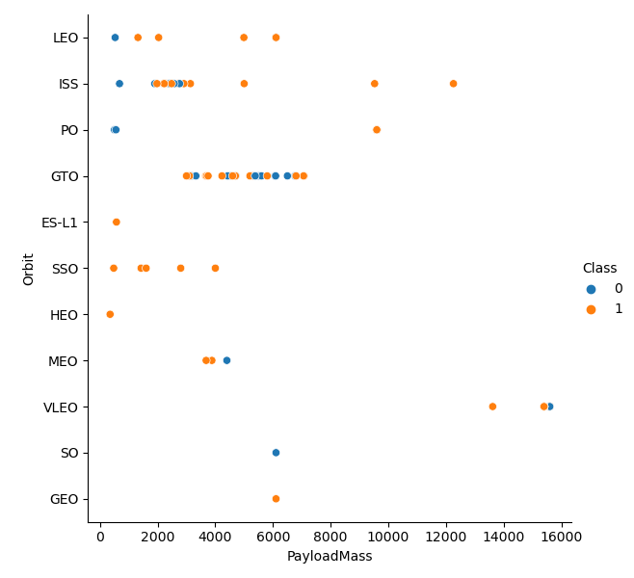
Payload vs. Orbit Type
As the payloads get heavier, the success rate increases in the PO, SSO, LEO and ISS orbits.
There seems to be no direct correlation between orbit type and payload mass for GTO orbit as both successful and failed launches are equally present.

Slide 23
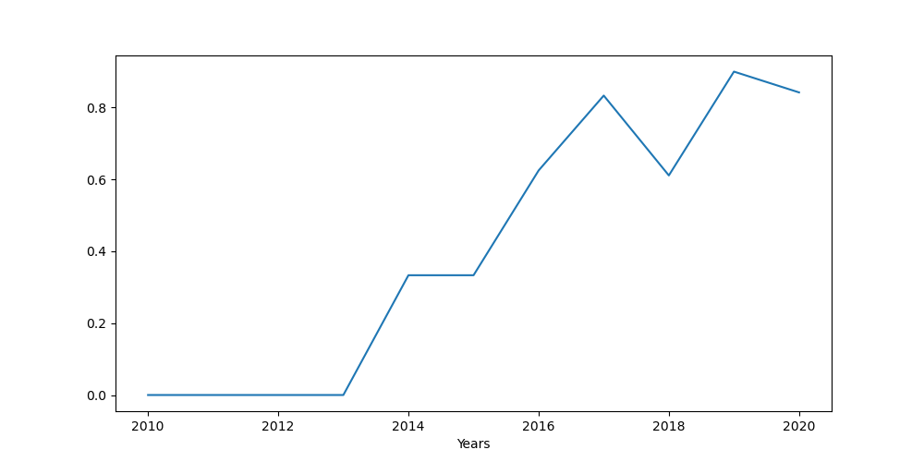
Launch Success Yearly Trend
The general trend of the chart shows an increase in landing success rate as the years pass. There is however a dip in 2018 as well as in 2020.

Slide 24
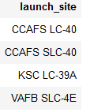
All Launch Site Names
Display the names of the unique launch sites in the space mission
The DISTINT clause was used to return only the unique rows from the launch site column.
The name of the launch sites are CCAFS LC-40, CCAFS SLC-40, KSC LC-39A, VAFB SLC-4E.

Slide 25
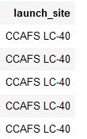
Launch Site Names Begin with 'CCA'
Display 5 records where launch sites begin with the string 'CCA'
The LIMIT and LIKE clauses were used to display only the top five results where the launch site name starts with 'CCA'

Slide 26
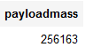
Total Payload Mass
Display the total payload mass carried by boosters launched by NASA (CRS).
The SUM() function was used to the calculate the total payload carried by boosters from NASA from the payload_mass_kg column.

Slide 27
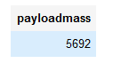
Average Payload Mass by F9 v1.1
Display average payload mass carried by booster version F9 v1.1
The WHERE clause was used to filter results so that the calculations were only performed on booster_versions only if they were named “F9 v1.1”

Slide 28
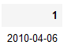
First Successful Ground Landing Date
List the date when the first successful landing outcome in ground pad was achieved.
Find the dates of the first successful landing outcome on ground pad.
The WHERE clause ensured that the results were filtered to match only when the 'landing_outcome' column is 'Success (ground pad)'

Slide 29
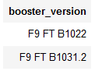
Successful Drone Ship Landing with Payload between 4000 and 6000
List the names of boosters which have successfully landed on drone ship and had payload mass greater than 4000 but less than 6000

Slide 30
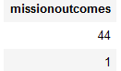
Total Number of Successful and Failure Mission Outcomes
Calculate the total number of successful and failure mission outcomes
The COUNT() function is used to count the number of occurrences of different mission outcomes with the help of the GROUPBY clause applied to the 'mission_outcome' column. A list of the total number of successful and failure mission outcomes returned.

Slide 31
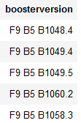
Boosters Carried Maximum Payload
List the names of the booster which have carried the maximum payload mass
The MAX() function was used in a subquery to retrieve a list of boosters which have carried the maximum payload mass

Slide 32
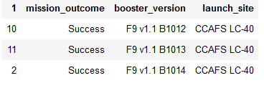
2015 Launch Records
List the failed landing outcomes in drone ship, their booster versions, and launch site names for in year 2015.
The SELECT statement was used to retrieve multiple columns from the table. The YEAR(DATE) function was used to retrieve only those rows with a 2015 launch date.

Slide 33
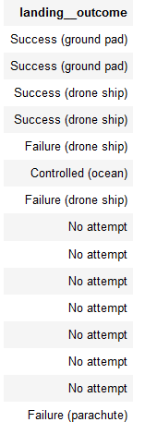
Rank Landing Outcomes Between 2010-06-04 and 2017-03-20
Rank the count of landing outcomes (such as Failure (drone ship) or Success (ground pad)) between the date 2010-06-04 and 2017-03-20, in descending order
COUNT() function was used to count the different landing outcomes.
The WHERE and BETWEEN clauses filtered the results to only include results between 2010-06-04 and 2017-03-20.
The GROUPBY clause ensure that the counts were grouped by their outcome. The ORDERBY and DESC clauses were used to sort the results by descending order.

Slide 34

Section 3

Slide 35
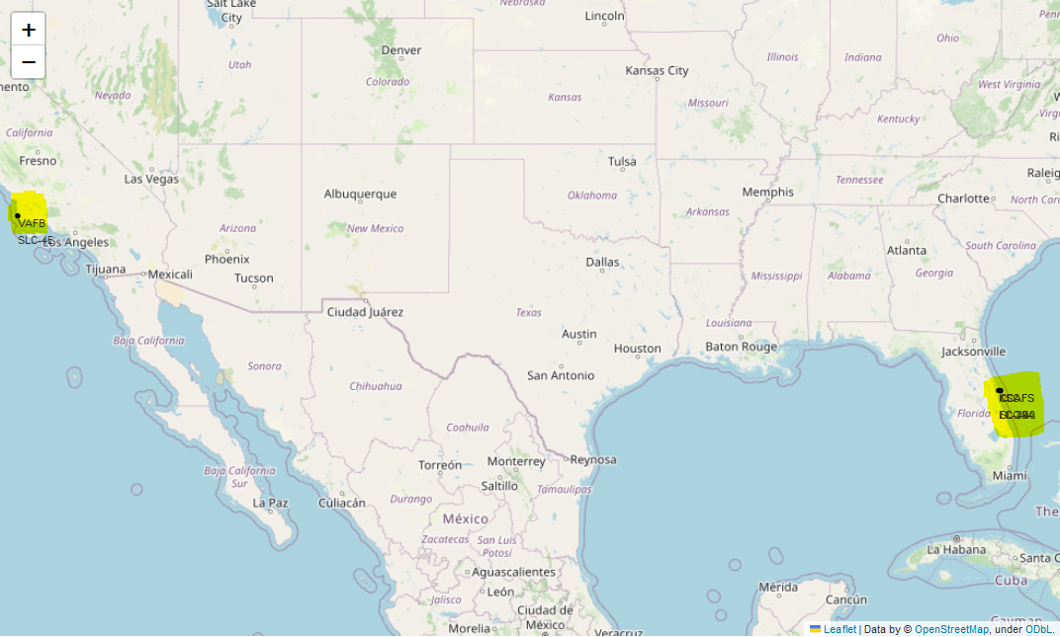
Mark all Launch Sites on a Map
The yellow markers are indicators of where the locations of all the SpaceX launch sites are situated in the US.
The launch sites have been strategically placed near the coast

Slide 36
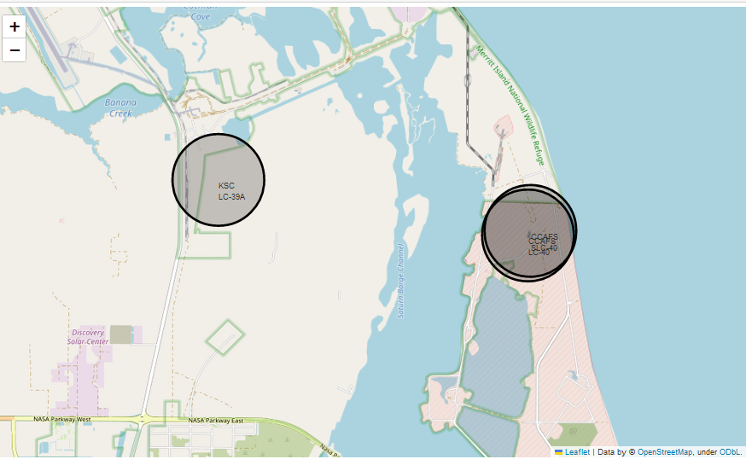
Mark the Success/Failed Launches for each Site on the Map
When we zoom in on a launch site, we can click on the launch site which will display marker clusters of successful landings (green) or failed landing (red).

Slide 37
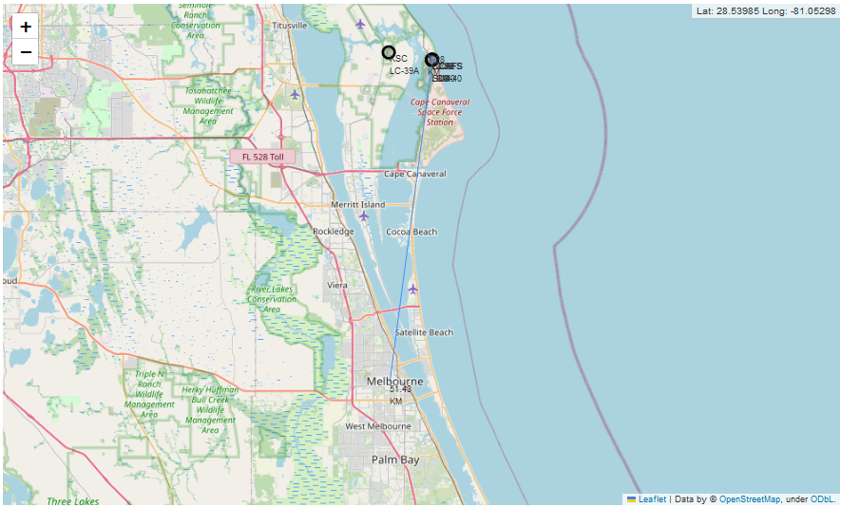
Calculate the Distances Between a Launch Site to its Proximities
The generated map shows that the selected launch site is close to a highway for transportation of personnel and equipment. The launch site is also close to the coastlines for launch failure testing.
The launch sites also maintain a certain distance from the cities. (Can be viewed in notebook).

Slide 38

Section 4

Slide 39
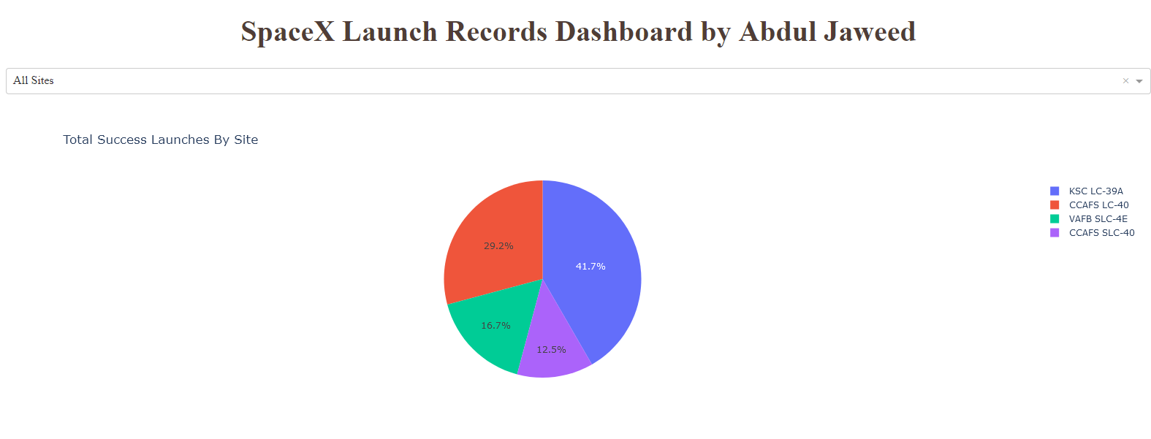
Total Successful Launches by Site

Slide 40
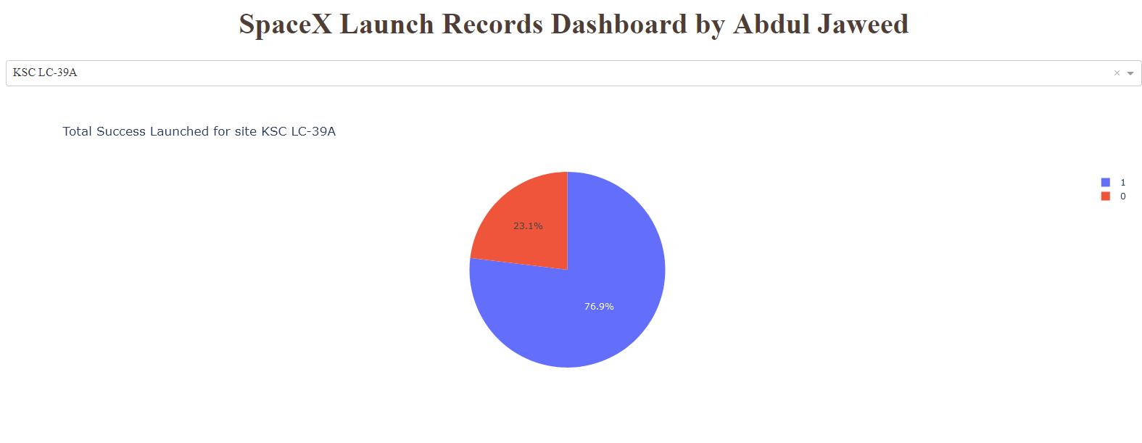
Launch Site with Highest Success Ratio

Slide 41
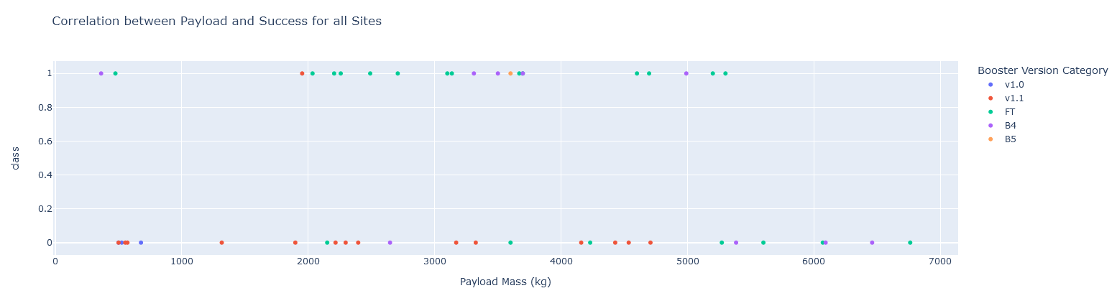
Correlation Between Payload and Success for all Sites

Slide 42

Section 5

Slide 43
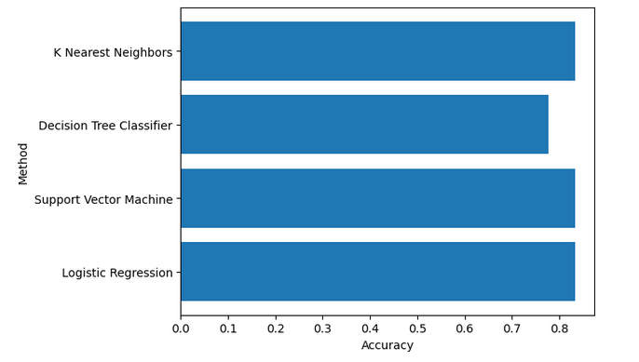
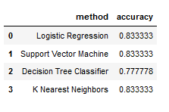
Classification Accuracy
Except Decision Tree the other three model like K Nearest Neighbors, Support Vector Machine and Logistic Regression Machine Learning Algorithms perform same accuracy 83%.

Slide 44
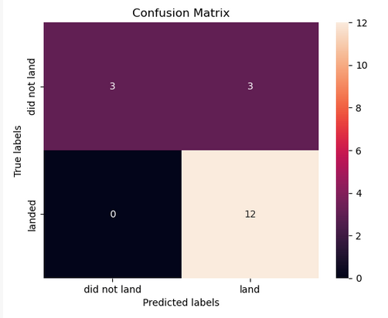
Confusion Matrix
The model predicted 12 successful landings when the True label was successful (True Positive) and 3 unsuccessful landings when the True label was failure (True Negative).
The model also predicted 3 successful landings when the True label was unsuccessful landing (False Positive).
The model generally predicted successful landings.

Slide 45
Conclusions
The analysis showed that there is a positive correlation between number of flights and success rate as the success rate has improved over the years.
The results of the (EDA) exploratory data analysis revealed the success rate of the SpaceX Falcon 9 rocket landings is 66%.
Orbit ES-L1, GEO, HEO, and SSO has a 100% success rates.
I deploy this dashboard on render web hosting service for better experience.
Except Decision Tree the other three model like K Nearest Neighbors, Support Vector Machine and Logistic Regression Machine Learning Algorithms perform same accuracy 83%.

Slide 46
Appendix
GitHub Repository Link : https://github.com/Abdul-Jaweed/SpaceX-Falcon9-Landing-Prediction
Dashboard Link : https://spacex-falcon9-landing-prediction.onrender.com/
Coursera Project Link : https://www.coursera.org/learn/applied-data-science-capstone?specialization=ibm-data-science#syllabus

Slide 47


